Slide 1



GREEN UNIVERSITY OF BANGLADESH
Blog Website : Online Story Telling Hub
Presented by:
Presented to:
Md. Zehadul Islam - 222902069
Mahbubur Rahman
Maruf - 222902037
Lecturer Dept. Of CSE
Green University Of Bangladesh
1

Slide 2

Introduction
A “blog website” is a digital platform that enables users to create accounts, write articles, and share multimedia content such as text, images, and videos. Through an intuitive web interface, users can publish, edit, and manage blog posts, while readers can browse, comment, and engage with the content. This system simplifies the process of content creation and interaction, fostering an online community for storytelling, knowledge sharing, and discussion—without the need for traditional publishing methods.
2

Slide 3
Objectives
01
02
03
Users can sign up and log in to the Blog Website.
Users are able to create and edit their own posts.
Users can view other users’ posts to get ideas and inspiration.
04
05
06
Posts are organized by categories, allowing users to easily find all content within a specific category.
The website displays recent trending and top posts, ensuring popular content is easily accessible.
Ensure users never miss out on the best and most updated posts through
3

Slide 4
TOOLS AND TECHNOLOGY
HTML
Visual Studio
CSS
XAMPP
PHP
Java Script
MySQL
4

Slide 5
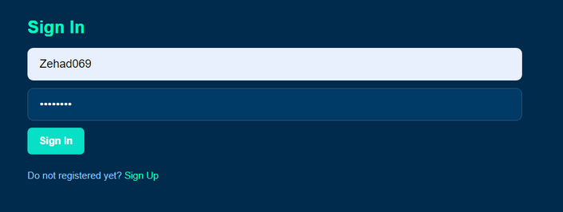


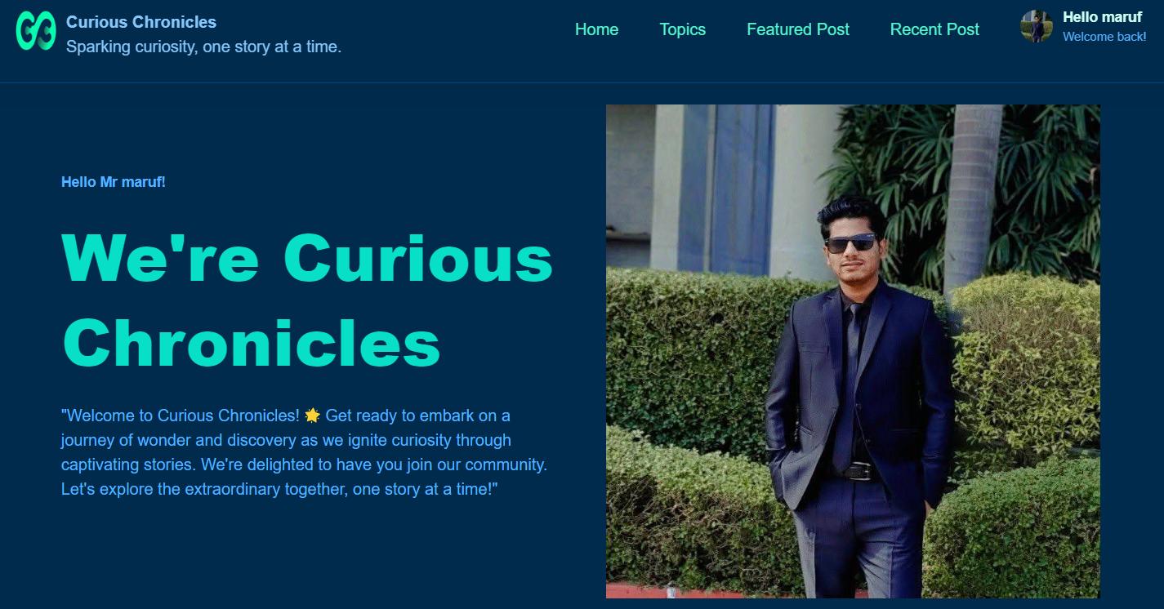

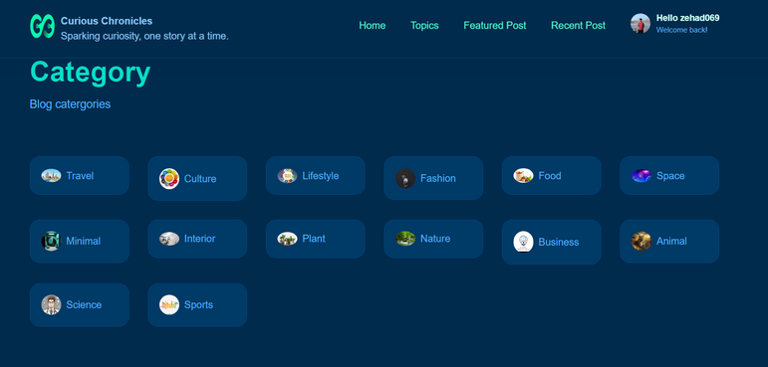
User InterFace
Sign In
Structure
User Profile and Home Page
Catagories
5

Slide 6
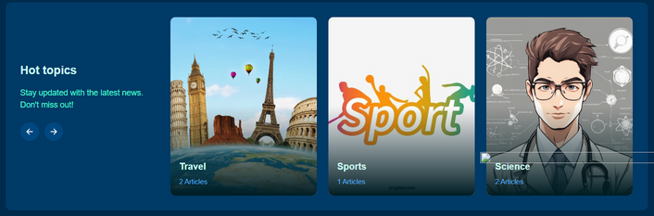
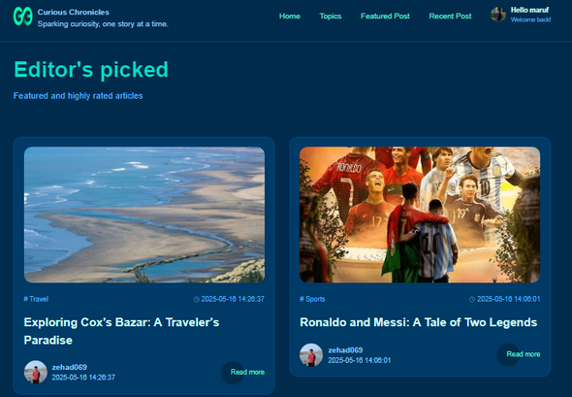
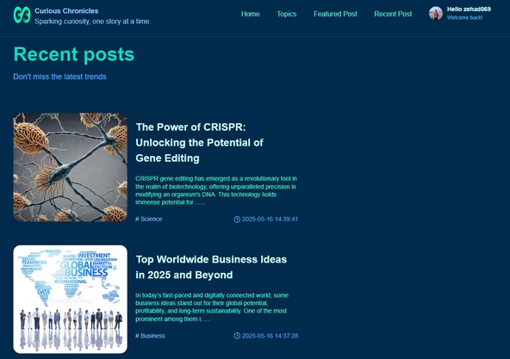
User InterFace
Show Latest news
Structure
Show Featured Mark
Post
Show Recent Post
6

Slide 7
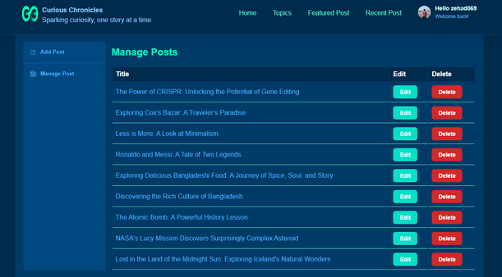
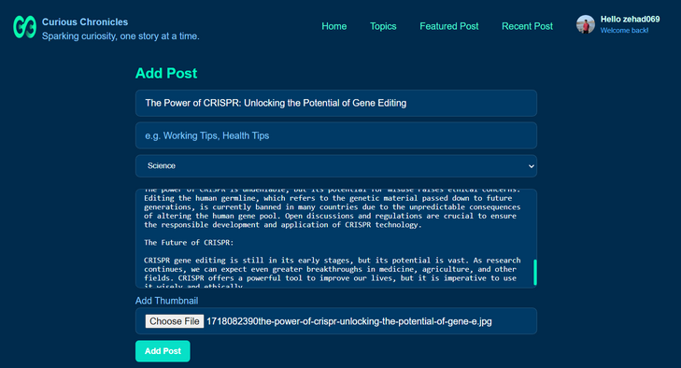
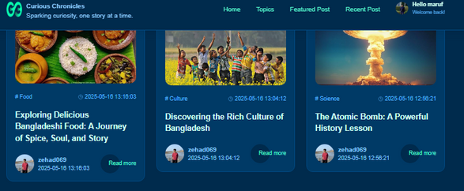
User InterFace
User Manage Post
Structure
Add Post.
Another user post showing
7

Slide 8
FUTURE WORK AND LIMITATIONS
Enhanced User Interaction
More Content Categories
Performance Optimization
SEO and Marketing
Improved Security
Mobile-Friendly Design
Analytics Integration
8

Slide 9
CONCLUSION
The Blog Website project provides a user-friendly platform where users can share their stories, ideas, and knowledge. With features like user registration, categorized content posting, and trending post updates, it supports both content creation and active user engagement. The responsive design and intuitive interface ensure a smooth experience across all devices. This project builds a strong base for developing an interactive online storytelling community.
9

Slide 10
Thank You
10

